Slide 1
Idea/approach details
Ministry/Organization Name:- NATIONAL CRIME RECORDS BUREAU
Ps no.:- SK215
Problem Statement:-Mobile Apps for Citizens and Police for management of
crime records.
Team Name:- Bits N’ Bytes
Team Leader Name:- Onkar Umesh Kadam
Team Leader Email ID:- onkarkadam27@gmail.com

Slide 2
Team details
Sr no. | TEAM MEMBERS NAME | BRANCH | YEAR | ROLL NO. | M/F
1. | ONKAR KADAM | IT | SY | 18141239 | M
2. | KSHITIJ BARGALE | IT | SY | 18141231 | M
3. | JASMIN ZARI | IT | SY | 18141150 | F
4. | SAGAR GAVHANE | IT | SY | 18141237 | M
5. | SANKET BENDALE | IT | SY | 18141233 | M
6. | SOHAM DHAWALE | IT | SY | 18141261 | M

Slide 3
IDEA/SOLUTION /PROTOTYPE DESCRIPTION
We have developed a mobile application for citizens and police for management of crime records. The main aim of our app is to remove barrier between citizens and police department. The app mainly focuses on well being of residents. The citizen can run the application remotely from anywhere, any time using Android Mobile. The user has to login into account for provision of services. The app contains various services which are directly helpful to citizen as per their requirement. This app will contains online applications and location based features. The administrator’s work is to provide nearby police stations, etc. This app will provide quick access to users by image capture and sound recording at a crime incident. The app will surely be a personal safety tool for citizens . In this way, the app will provide safety, empowerment and the most important thing convenience to common man.

Slide 4
Effective Points
1] Quick Access to citizens by image capturing and sound recording features at a crime incident.
2] Help me message! Feature.
3] Location based features.
4] NOC applications and crime reporting feature , etc.

Slide 5
ADVantages
Security
Reduces time
Reduces human efforts.
Crime management
Easy to use
Smart Policing

Slide 6
Market Implementations
Sometimes we found distressed at times and required urgent help . Sometimes we become victim. So this app will provide easy way of crime reporting . This app will empower the common man .

Slide 7
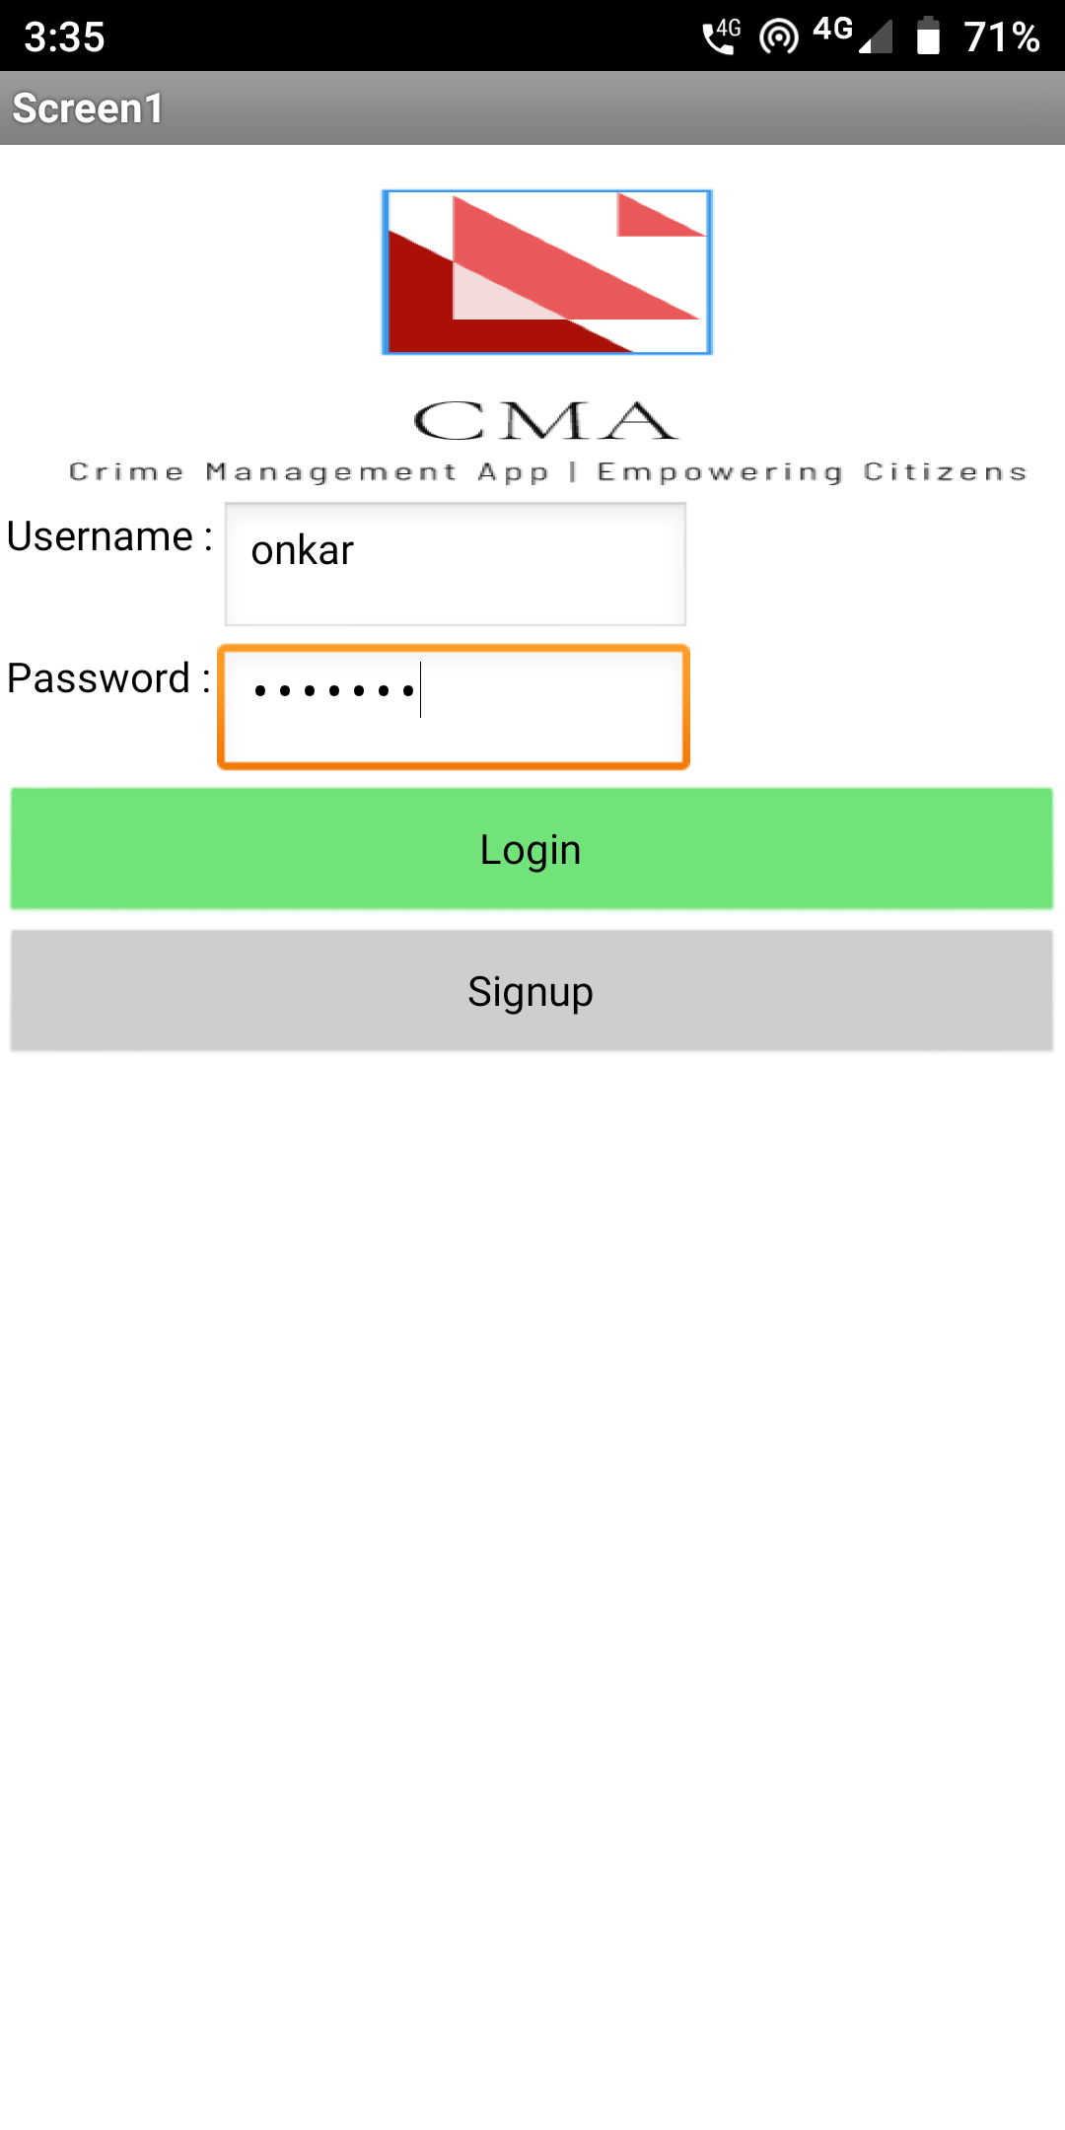
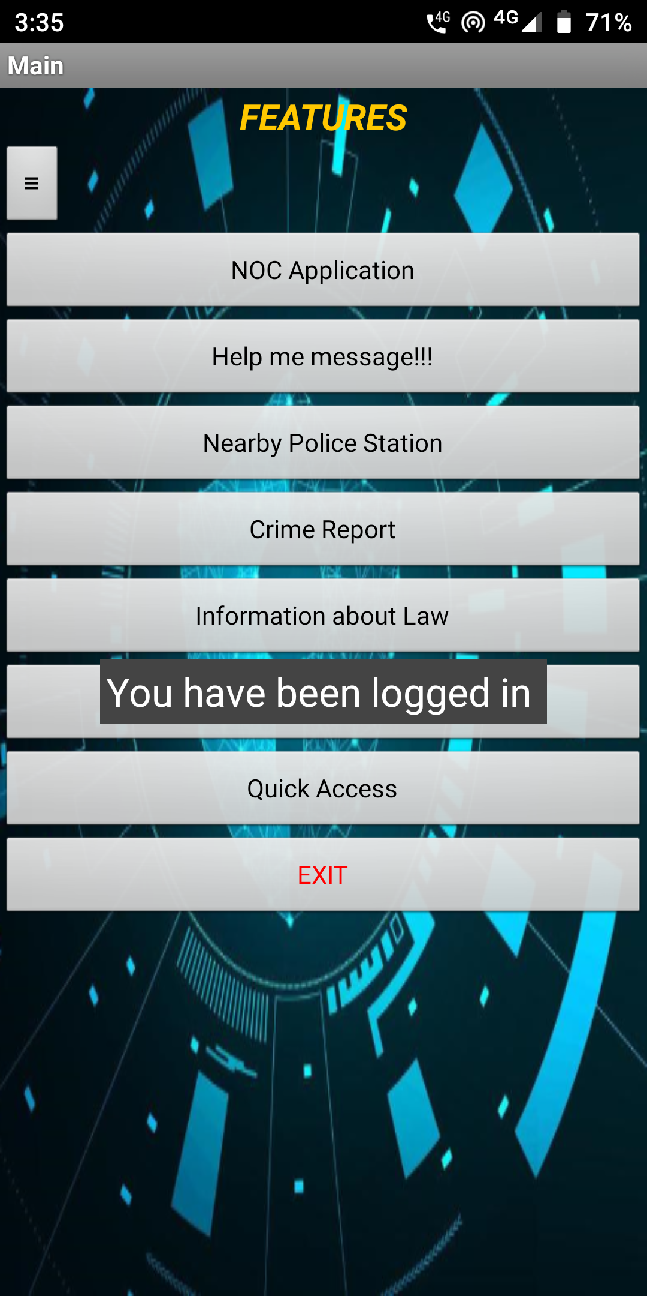
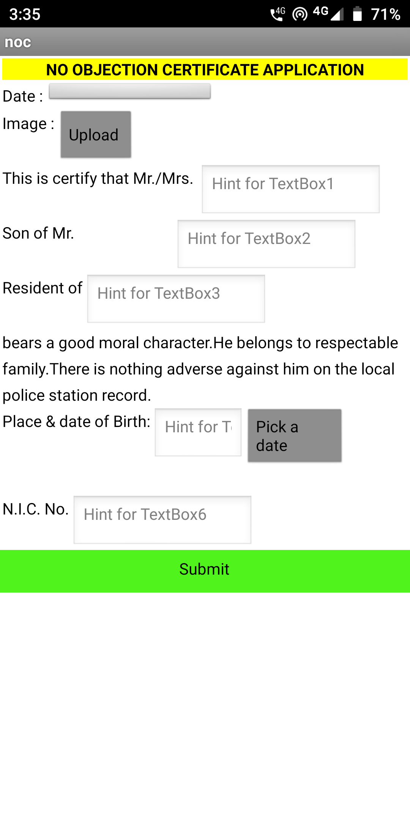
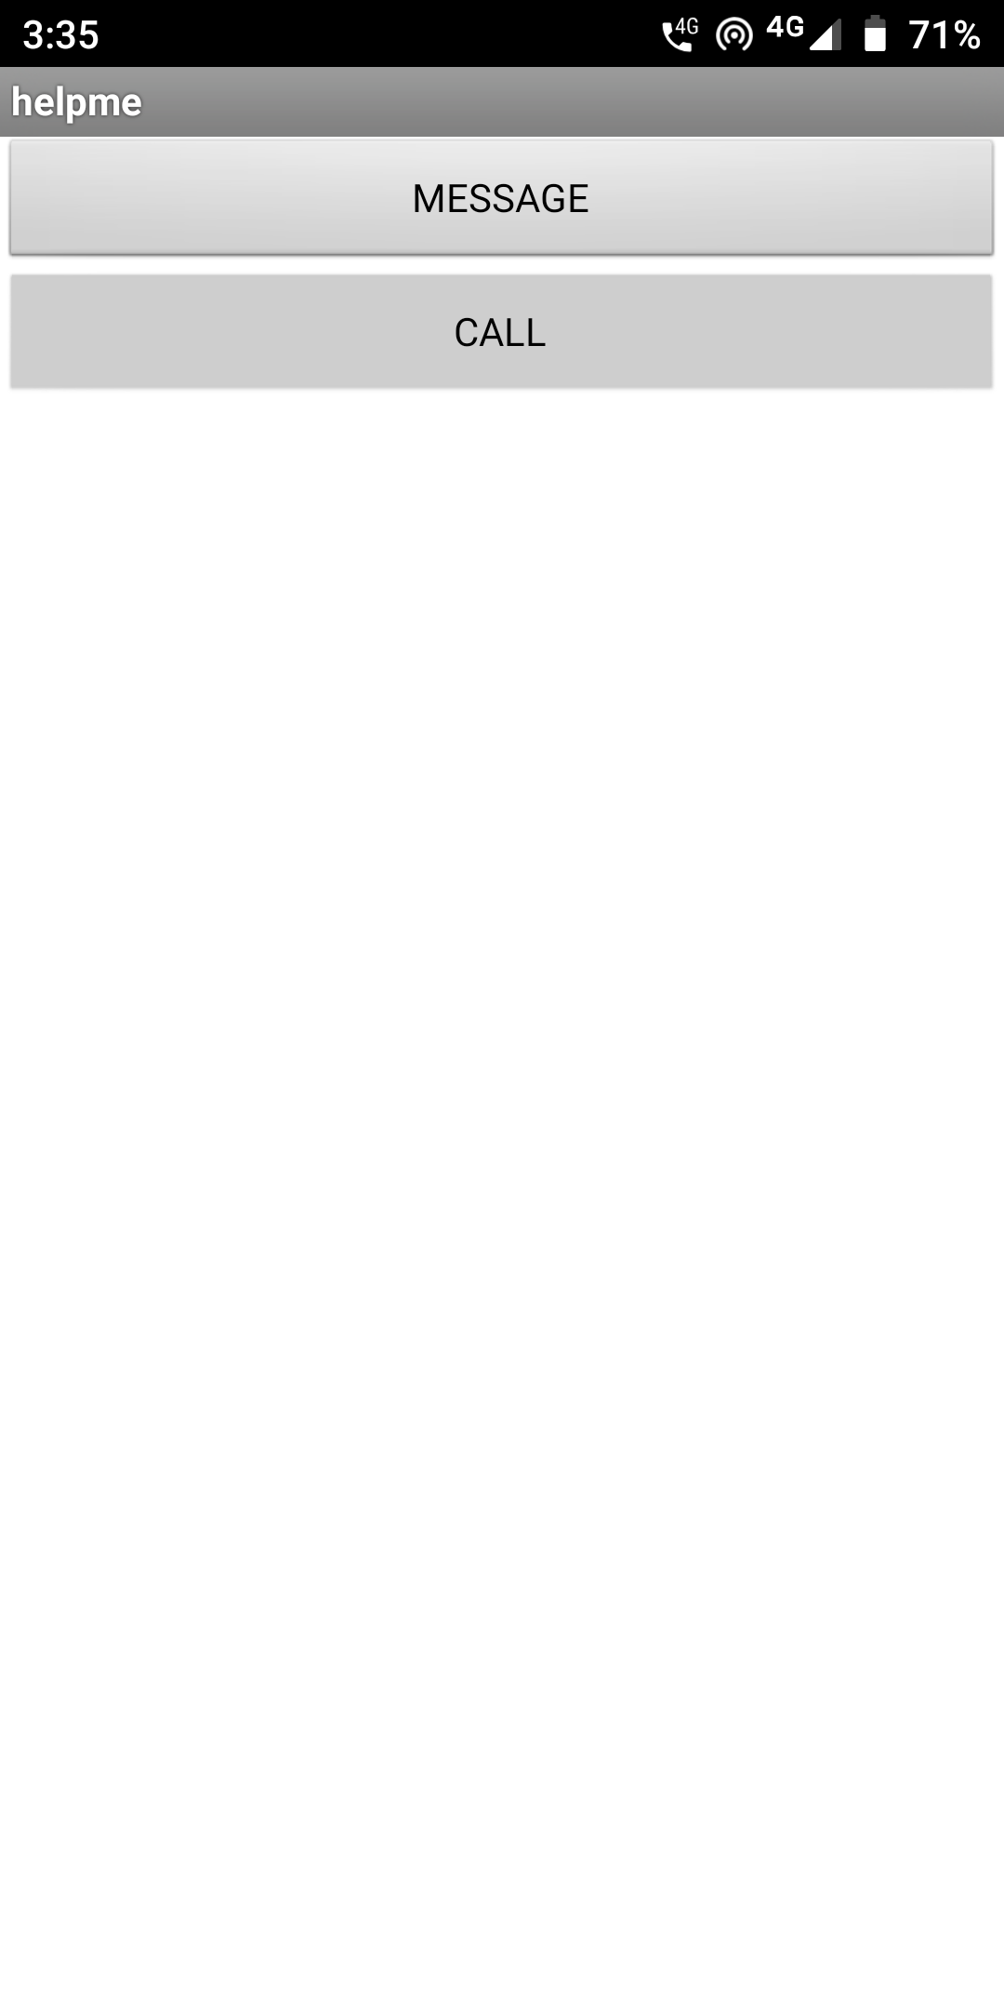
Results

Slide 8
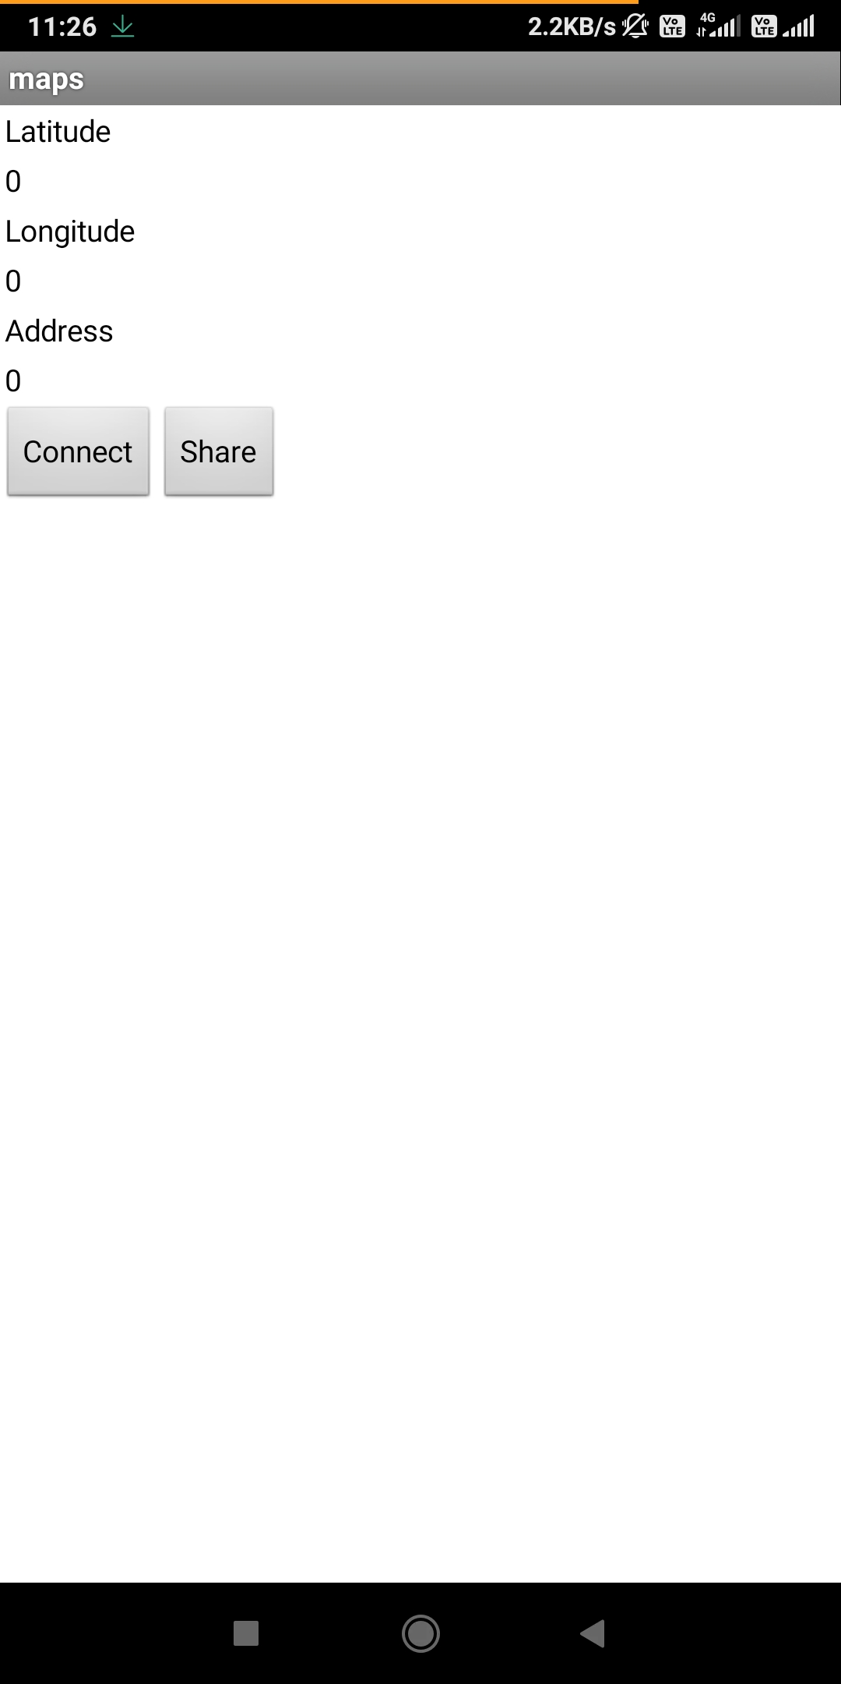
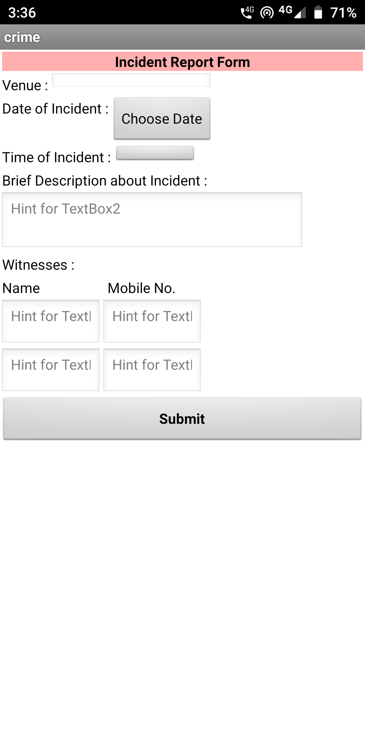
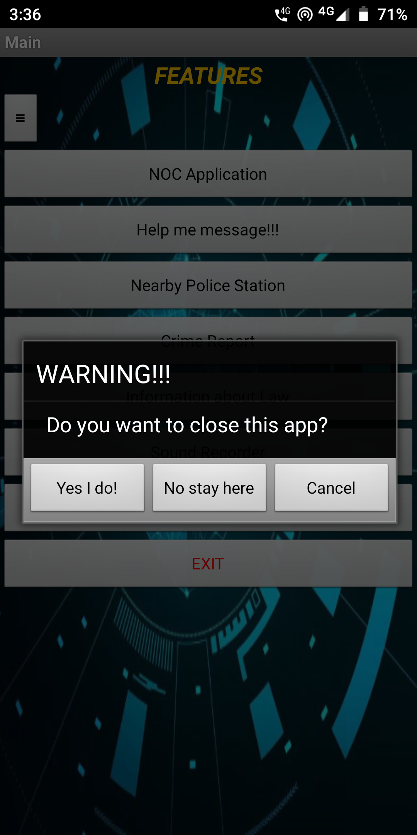
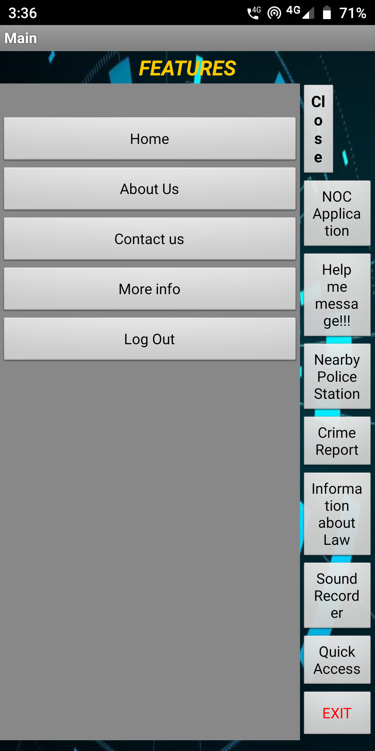

Slide 9
FUTURE SCOPE
News Feed
All nearby police stations
OTP generation to make it more secure

